Slide 1

The Battle of Neighbourhoods
by Kristina Valentova

Slide 2
INTRODUCTION
Situated on one of the world's largest natural harbours, New York City, is the most populous city in the United States. Composed of five boroughs, Brooklyn, Queens, Manhattan, the Bronx, and Staten Island, each of which is a county of the State of New York. As many as 800 languages are spoken in New York, making it the most linguistically diverse city in the world. New York is home to more than 3.2 million residents born outside the United States. The city is renowned for its diversity, also reflected in food and beverage industry, with cuisines from France, Italy, India, Hungary, China and other parts of the world.
A business entrepreneur would like to expand his restaurant business to the United States and requested data that would help him make an informed decision on the best location in New York city to open a unique Indian restaurant.

Slide 3
APPROACH
To answer the above task, we will need answers to the following questions:
Q1 - List/visualise all major parts of the city of New York with restaurants serving Indian cuisine.
Q2 - Which areas lack restaurants serving Indian cuisine?
Q3 - Which areas have potential Indian cuisine market?
Q4 - What is the best location to open a new unique Indian cuisine restaurant?

Slide 4
DATA REQUIRED
For this project we need the following data:
New York City data that contains list Boroughs, Neighbourhoods along with their latitude and longitude.
Data source : https://cocl.us/new_york_dataset
Indian restaurants in each neighbourhood of New York City.
Data source : Foursquare API
GeoSpace data
Data source : https://data.cityofnewyork.us/City-Government/BoroughBoundaries/tqmj-j8zm

Slide 5
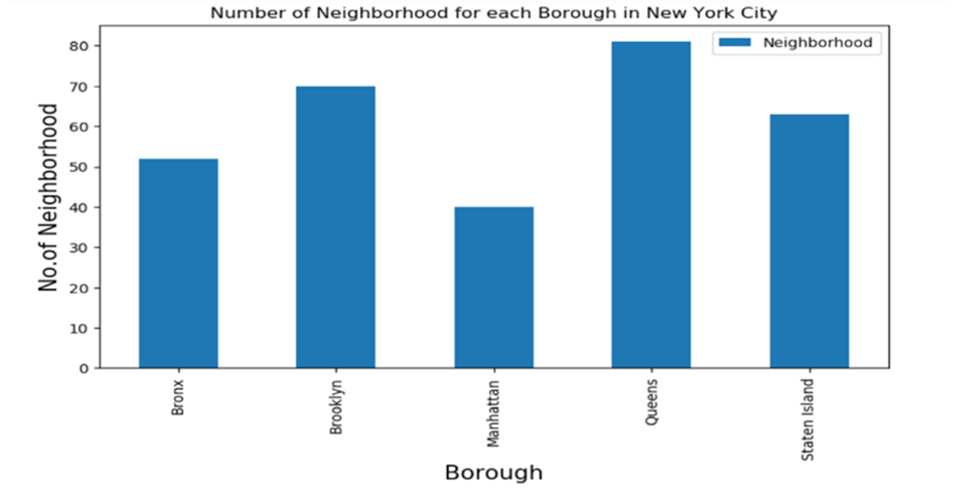
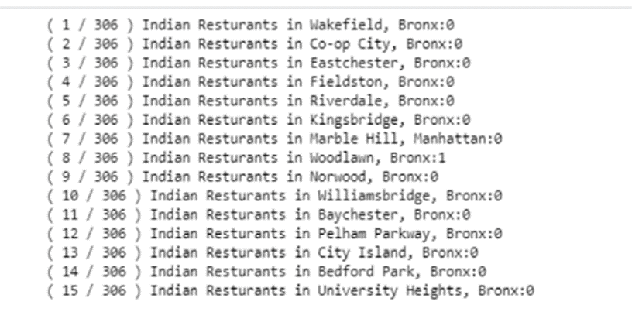
DATA
Number of Neighbourhoods for each borough
Indian restaurants

Slide 6
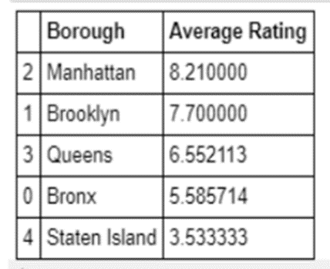
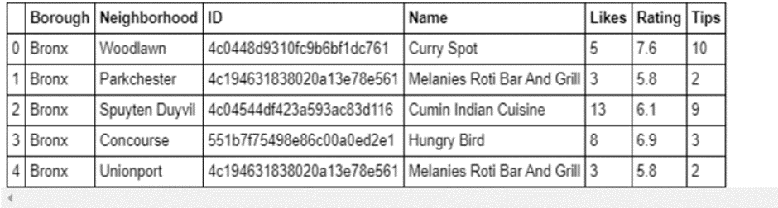
DATA
Ratings
Ratings Boroughs

Slide 7
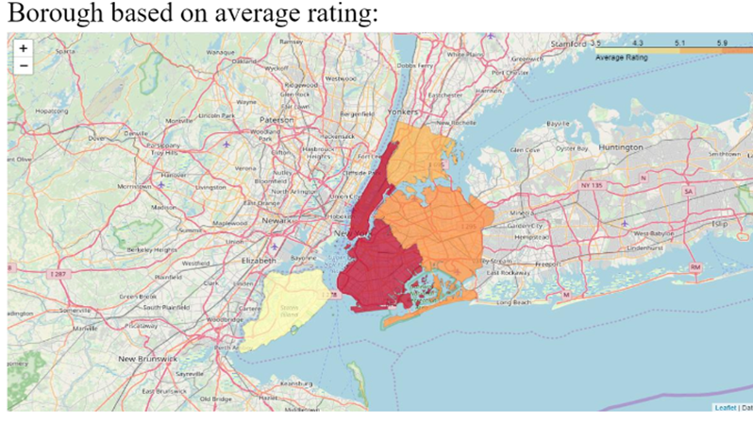
Boroughs based on average rating

Slide 8
RESULT
Q1 - List/visualise all major parts of the city of New York with restaurants serving Indian cuisine.
A1 - See the above map.
Q2 - Which areas lack restaurants serving Indian cuisine?
A2 - Staten Island ranks last in average rating of Indian Restaurants.
Q3 - Which areas have potential Indian cuisine market?
A3 - Manhattan have potential Indian Restaurant Market.
Q4 - What is the best location to open a new unique Indian cuisine restaurant?
A4 - Astoria (Queens), Blissville (Queens), Civic Center (Manhattan) are some of
the best neighbourhoods for Indian cuisine.

Slide 9

CONCLUSION
The result is based upon currently available data. These can change over time so time span needs to be considered when using this report as a basis for any business decisions.

